Slide 1
PEACE AND CONFLICT RESOLUTION
(GST 312)
Facilitator:
Mr. Ikechukwu Alamezie
13th October, 2026

Slide 2

Preliminaries

Slide 3

What is this course about?
The course is an introduction to:
The basic ideas on the concept of peace, conflict and security.
The major types/forms, theories & root causes of conflict and violence.
The difference between conflict and terrorism.
The basic elements of peace studies and conflict resolution.
Security and peacebuilding strategies.
The roles of international organizations, media, and traditional
Institutions in peacebuilding.

Slide 4


















What will we learn?
By the end of this session, you should be able to…

Slide 5
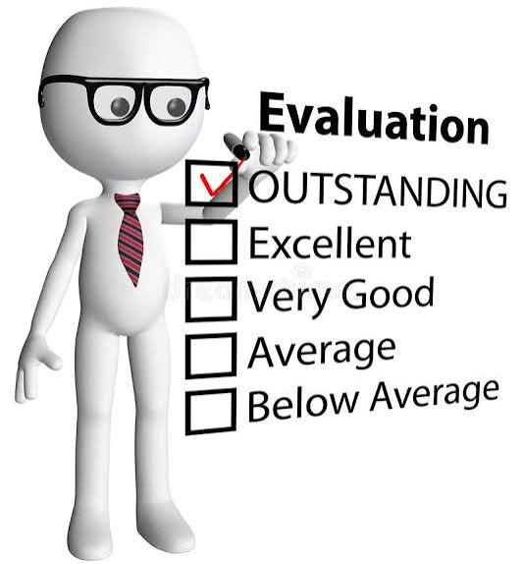
Modalities for Assessment
There will be continuous assessment (CA) and a final
examination.
The breakdown of scores is as follows:
30% - Continuous assessment
65% - Exam
5% - Class participation
Evidence of independent thinking and research is considered
in the assessments.
Modality for Continuous Assessment:
CA1 15% Class test
CA2 15% Group work

Slide 6

Course Outline
Introduction to peace, conflict and security.
Types and theories of conflict
Root causes of conflict and violence in Africa
Case studies
Peace-building and conflict management
Elements of peace studies and conflict resolution
Peace mediation and peace keeping
Agents of conflict resolution/ ADR
Roles of International Organizations in conflict
resolution
Media and traditional institutions in peace building
Managing post-conflict situation/crises

Slide 7
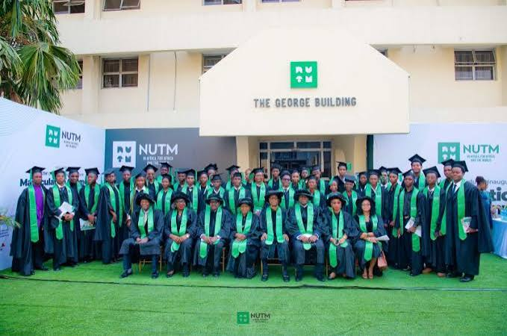
Let’s get down to business

Slide 8

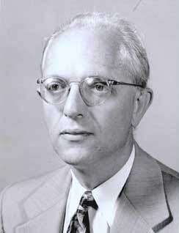
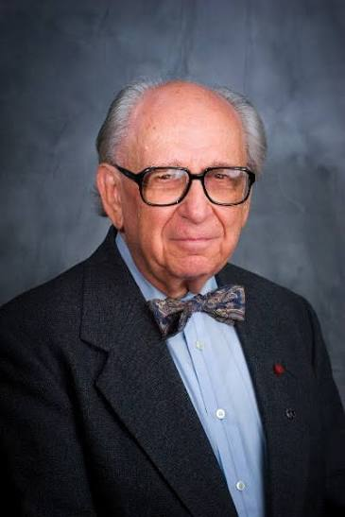
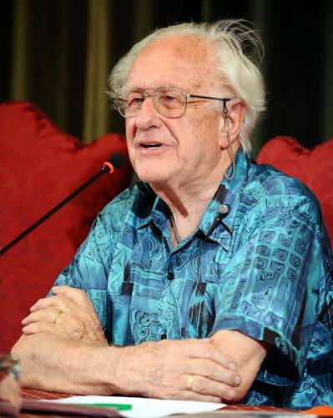
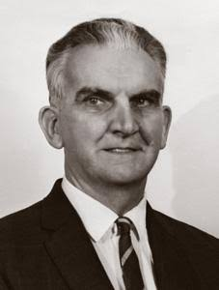
Peace Studies was born in North America in the 1950s and Norway in 1960s.
Kenneth Boulding
Anatol Rapoport
Herbert kelman
Johan Galtung
Mission: To contribute to promoting a world where the fundamental human rights of all human beings beyond ethnic, cultural and religious lines are respected and protected. Participatory decision-making process is secured and widely practiced, and basic needs of all are equally satisfied.

Slide 9
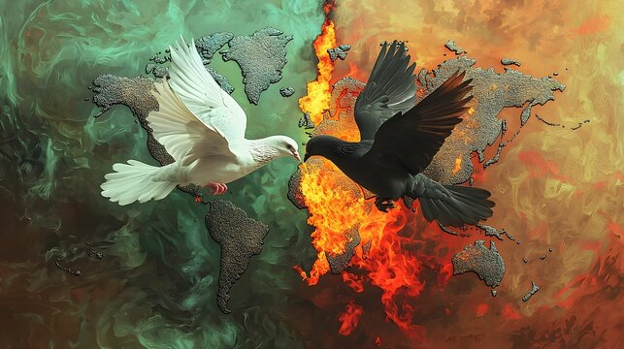

What is Peace?

Slide 10

Some perspectives?
Many disciplines have provided different approaches to the phenomenon of peace
Human Rights | Peace is a relative condition of security friendly climate that allows individuals and group relations to progressive order and stability (Akpuru-Aja, 2007)
Sociology | Peace as a value emanates from just human relationships which enhance social harmony, creativity and productivity and prevention of war (Ikejiani-Clark and Ani, 2009)
Religion | Peace is both a gift from God and an effort by the people to achieve it individually and socially.
Psychology | Peace is the ability to meet one’s needs, thus creating a state of calmness. The ability to function without threat or fear.
Marxist | Peace is relative to the equal distribution of resources among the classes (bourgeois, proletariats and the peasants) of the society (Richard, 2008)
Legally | Peace is a state of law and order. Peace can be constructed and achieved through executive, legislative and judiciary structures and institutions of a state (Galtung, 1996).

Slide 11

How would a student define peace?

Slide 12

THE CONCEPT OF PEACE
Peace is a state of harmony
characterised by justice.
A peaceful state is devoid of
violence, war, and threat to
human freedom and dignity.
Interior peace is manifest in
exterior peace.

Slide 13
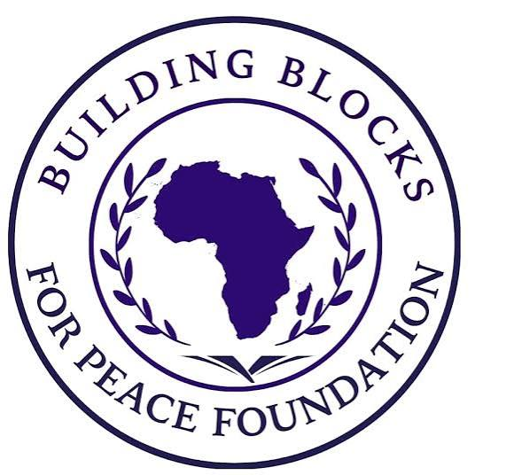
Foundations of Peace
Peace rests on:
Christian identity of man (NOT as opposed to any other religion).
Respect for human dignity.
Respect for freedom.
The other as a gift – “I-thou”.
Respect for one’s religious beliefs.
Just laws.
Respect for truth – responsible media.

Slide 14

LEVELS OF PEACE
Social Peace
Personal Peace
International Peace
when people in a
Community live
together with
mutual respect,
justice, and
cooperation.
refers to inner
calm, emotional
balance, and
mental well-being.
the absence of war
and the presence of
friendly relations
between countries.

Slide 15
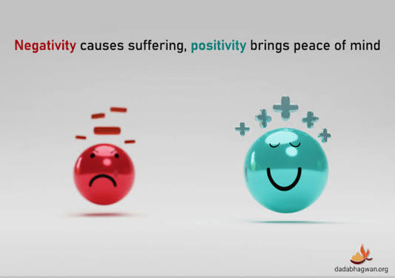
TYPES OF PEACE
Positive Peace
Involves the presence of justice, equality, good governance, and
social harmony and the enthronement of human security. It addresses
the root causes of conflict such as poverty, discrimination, and marginalization.
Negative Peace
Refers to the absence of direct violence or conflict.
For example, a society may not be at war but still
experience tension or inequality.

Slide 16

How do I pursue Peace in a multi-ethnic society?
This requires:
1. Mutual respect among ethnic groups
2. Fair distribution of resources
3. Inclusive governance
4. Recognition of cultural identities
Without these, underlying grievances may persist even in the absence of open violence.

Slide 17

Thank you
For more information, please contact:
Nigerian University of Technology and Management
6, Freetown Road, Apapa, Lagos
Email: info@nutm.edu.ng

